Slide 1
Measuring plasma velocities in Coronal loops using Hinode/EIS spectroscopic data to constrain eruption models
Aspiring Scientists Summer Internship Program 2025
Canyon Natinsky¹, Yousef Malik¹, Kavin Kumar¹, Dr. Arthur Poland¹
¹Department of Physics and Astronomy, College of Science, George Mason University
Notes:
READ ME: 2025 ASSIP Presentation Template Instructions
Read this section before using the template.
Questions? Email Dr. Haymond Still at cosassip@gmu.edu
This is a template for you to use as is or modify WITH MENTOR’S input.
Your mentor must approve your slide deck!
Remember to save the finished slides under the file name:
MentorsLastName_YourFirstName_YourLastName_2025ASSIP_PRESENTATION
Submit the slides of the saved presentation to Dr. Haymond Still no later than 5pm on Thursday, July 31st
Slide specific Notes: Replace the “FirstName LastName” text with the names of all authors of the study. The first name should be yours (it’s your poster!), and the last name should be your mentor’s. In between are the other graduate students, postdocs, research faculty, or other ASSIP interns who contributed to the project.
After each name, you’ll have a superscript that denotes the affiliation of the author. For you, you are welcome to list your high school or college. Most of the affiliations will be something like this: “Department of Computer Science, College of Engineering and Computing, George Mason University, Fairfax, VA” or “Center for Applied Proteomics and Molecular Medicine, College of Science, George Mason University, Fairfax VA.” Ask your mentor about their department if you aren’t sure what it is.

Slide 2
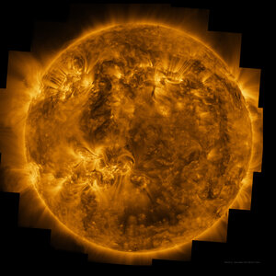
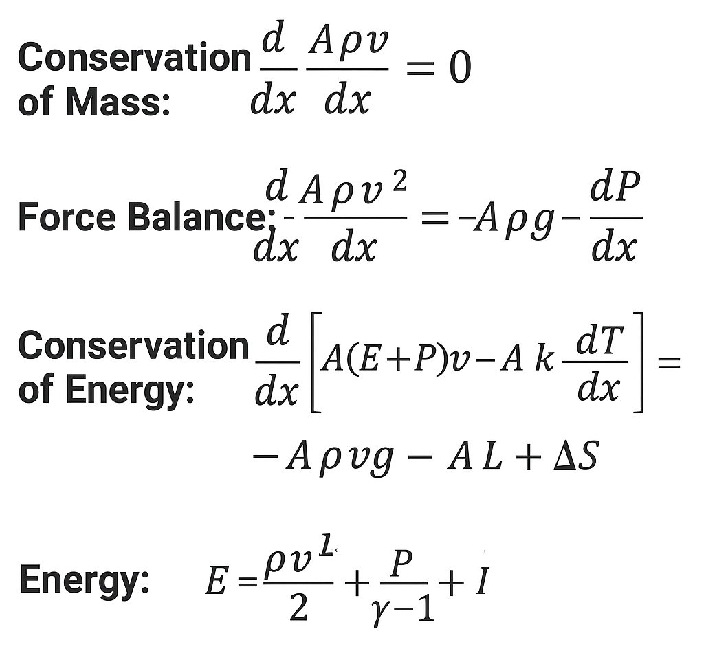
Background
https://www.esa.int/ESA_Multimedia/Images/2024/11/EUI_s_view_of_the_Sun_in_UV_light
The Sun's outer atmosphere, or corona, is filled with arch-like magnetic structures commonly known as coronal loops.
  They reach up to 1-6 Million Kelvin
One of the biggest challenges is the lack of direct observational data that can validate or improve existing physical models.
  Current models are based on basic magnetohydrodynamic equations, as shown to the right.
Velocity is a significant parameters in these equations.
This work is focused on measuring the velocity.
Understanding these motions help us understand the solar eruptions that can interfere with Earth’s technology and power systems.
Captured photo of sun with loops extending beyond surface
Relevant equations for predicting coronal loop physical processes

Slide 3
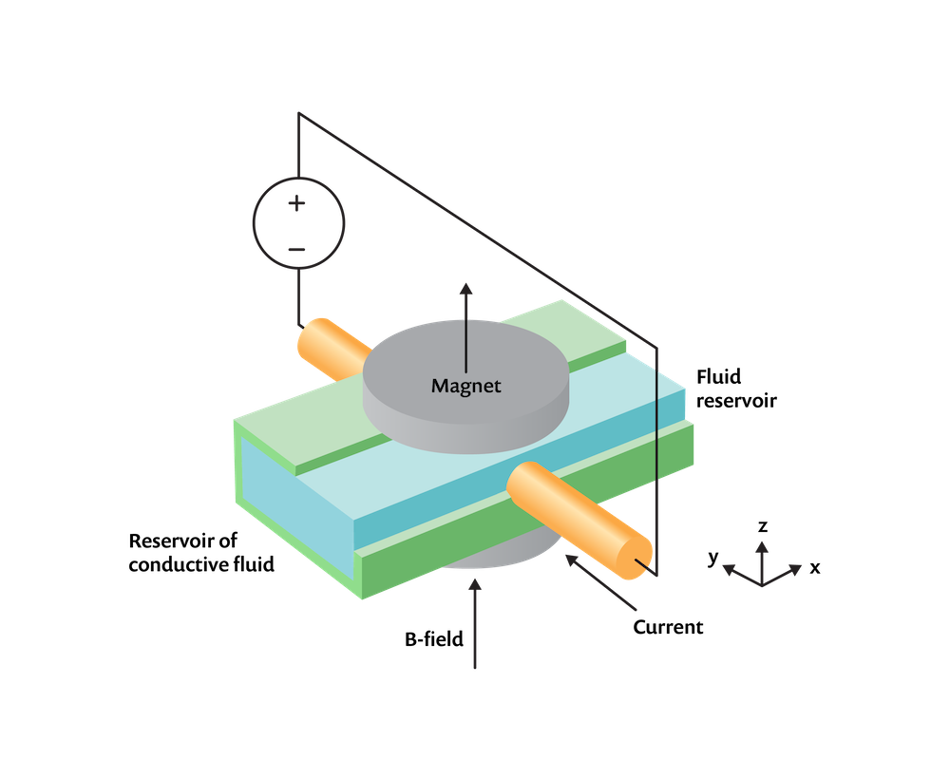
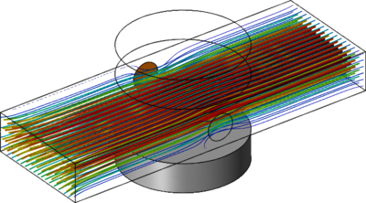
Research Question
What are the plasma velocity fields within coronal loops across different temperatures, positions, and structures, and how can these observational measurements improve the accuracy of magnetohydrodynamic (MHD) models of coronal heating and eruptions?
https://www.comsol.com/blogs/building-a-magnetohydrodynamic-multiphysics-model-in-comsol
Magnetohydrodynamic Model Diagram
Magnetohydrodynamic Model Example
https://www.comsol.fr/model/magnetohydrodynamics-74511

Slide 4
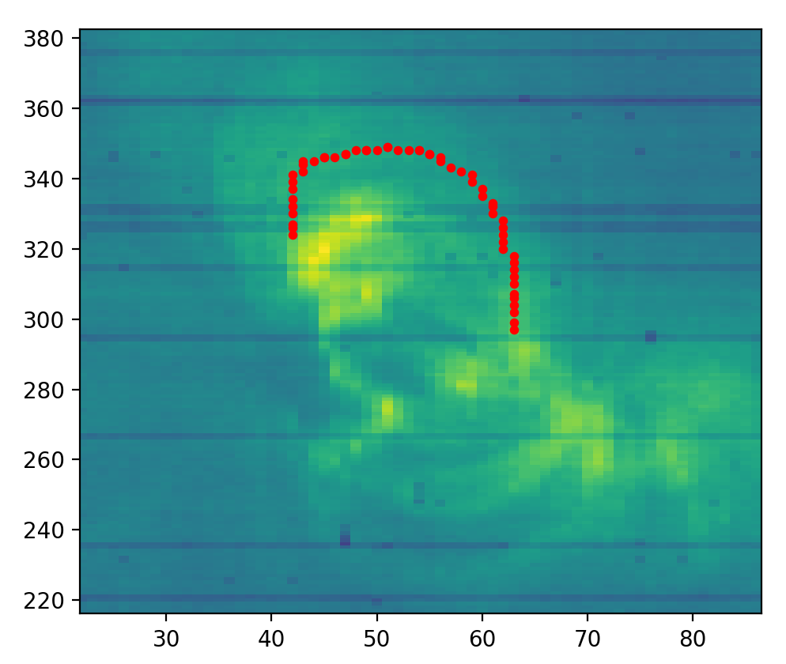
Materials and Methods
Our study began by discovering and retrieving extreme-ultraviolet spectroscopic data from the EUV Imaging Spectrometer (EIS) on the Hinode satellite. While this dataset spans around 19 years, this research specifically focuses on observations from April 4th, 2019 at 13:15:13.
Plotted the intensity as a function of position for a specific emission line, as shown in the intensity map figure. Then, we selected around 50
points on manually identified coronal loops.
Since EIS is a spectrometer, the next thing
we accomplished is plotting intensity as a
function of wavelength to observe the most
reliable wavelengths and assign them to their
respective window for future use.
Intensity map with plotted points of example loop

Slide 5
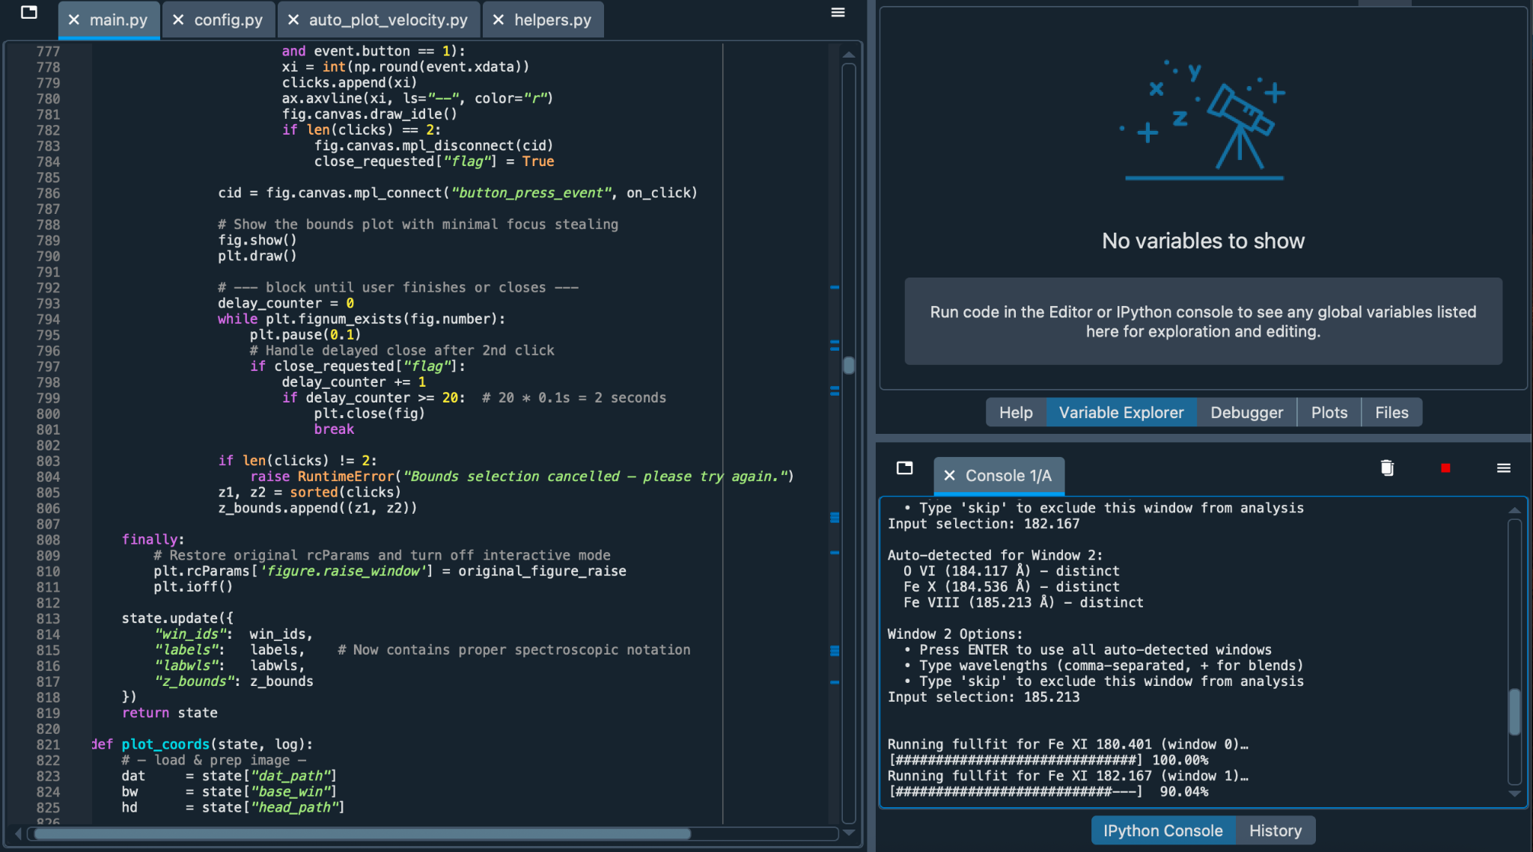
Materials and Methods
We can then set bounds to the wavelength to
further refine the gaussian fit, and even specify
a blend of wavelengths to prompt a double
gaussian fit.
By creating and using our very own
Python-based analysis tool, developed with
the help of the EISPAC module, we interpret
Doppler shifts in the spectroscopic data to
derive line-of-sight plasma velocities for each
plotted point.
These measurements are designed to be compared to existing theoretical models to test and refine our understanding of the heating and eruption mechanisms in these loops.
Python program running inside Spyder (IDE)

Slide 6
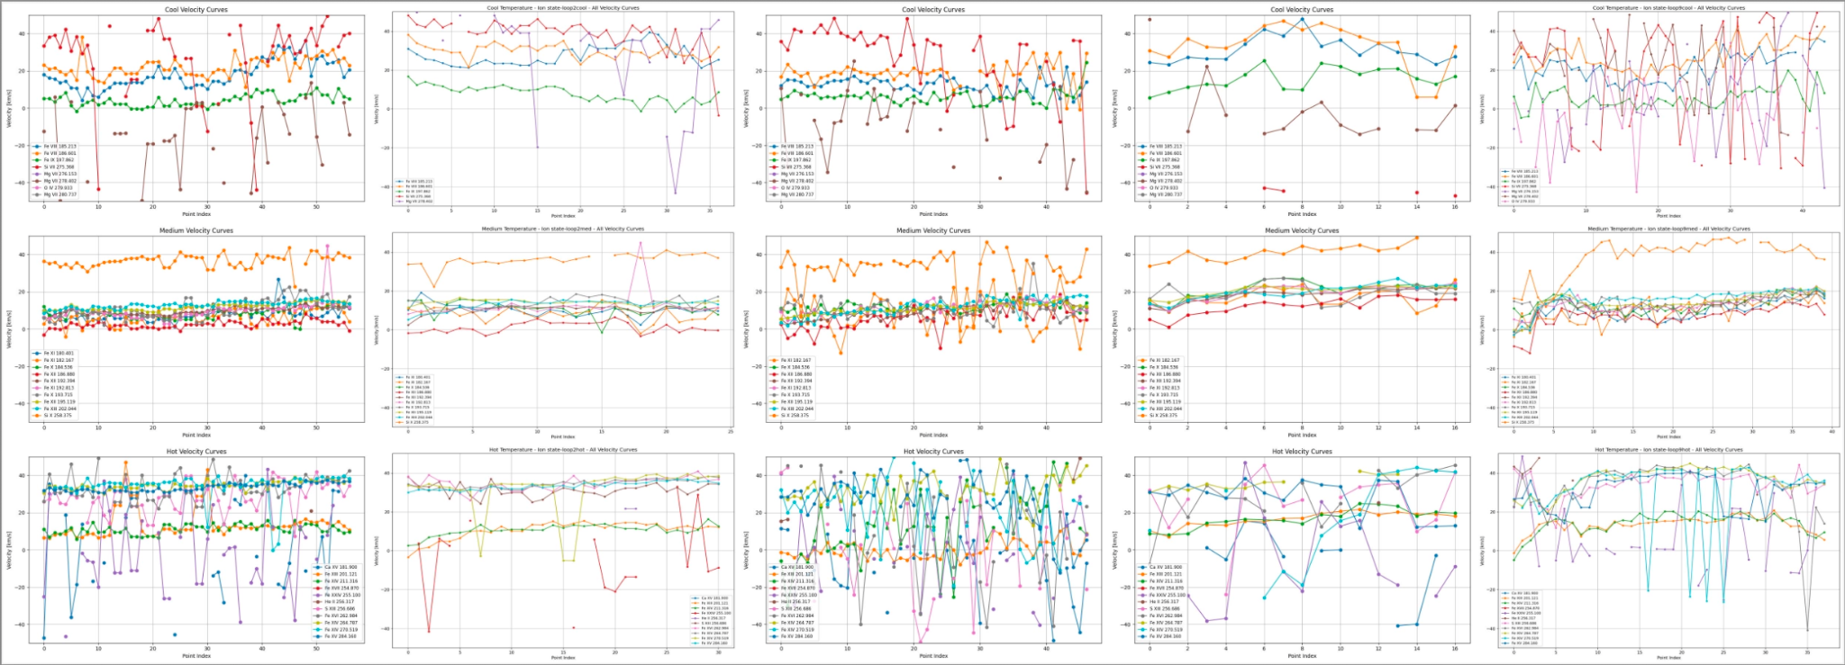
Results
We present here the velocity measurements of ions, grouped by temperature, for several loops.
Notes:
1, 3, 4 together. 2,5 not reliable noisy y-shift etc.
You can see for example, most pronounced middle row (med temp), closely packed so giving consistent velocity. same velocity at both edges and throughout loop. not like we're seeing center moving slower (consistent). However, all graphs show that from all loops. color lines and hoter are noisier cus many are weaker but even they show the same behavior.

Slide 7
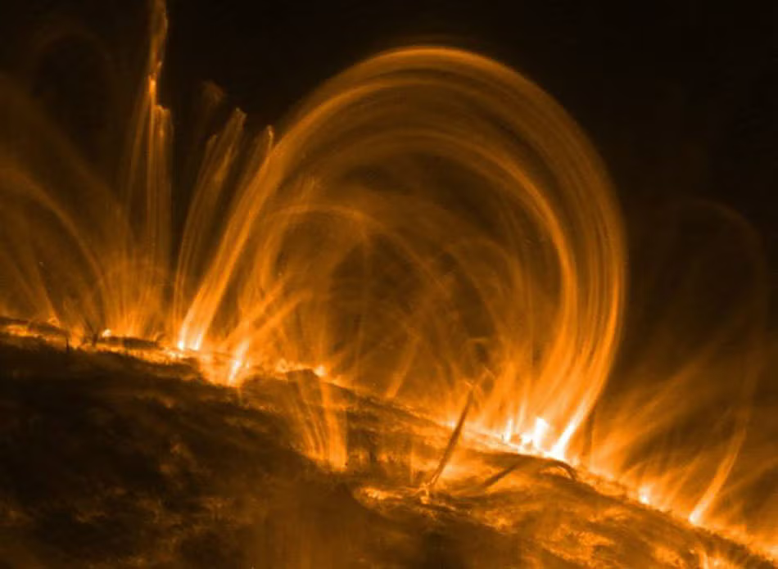
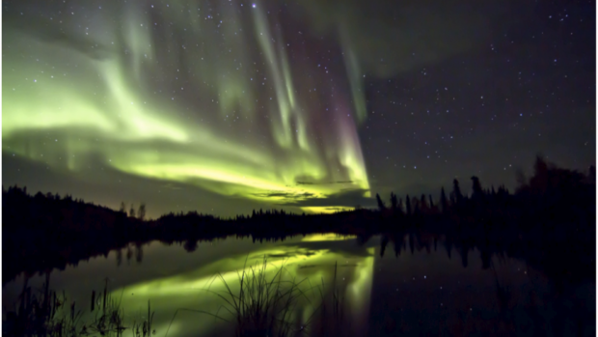
Conclusions
We successfully developed a Python-based analysis model using EISPAC modules to process far-ultraviolet imaging Spectrometer data from the Hinode satellite, efficiently.
Measured the plasma velocities between elements across a wide temperature range of 500 thousand - 6 million Kelvin using Doppler shift analysis.
The velocity profiles are generally showing a downward velocity throughout multiple loops in the dataset.
This is inconsistent with hydrodynamic models. This implies that the magnetic field is moving all of the material coherently.
This understanding will hopefully lead to better prediction of geomagnetic storms.
https://news.ucar.edu/132830/solar-illusion-coronal-loops-may-not-be-what-they-seem
Coronal Loop Eruption
Aurora Borealis
https://www.swpc.noaa.gov/phenomena/geomagnetic-storms
Notes:
Doppler shift: difference in wavelengths emitted by a celestial object

Slide 8
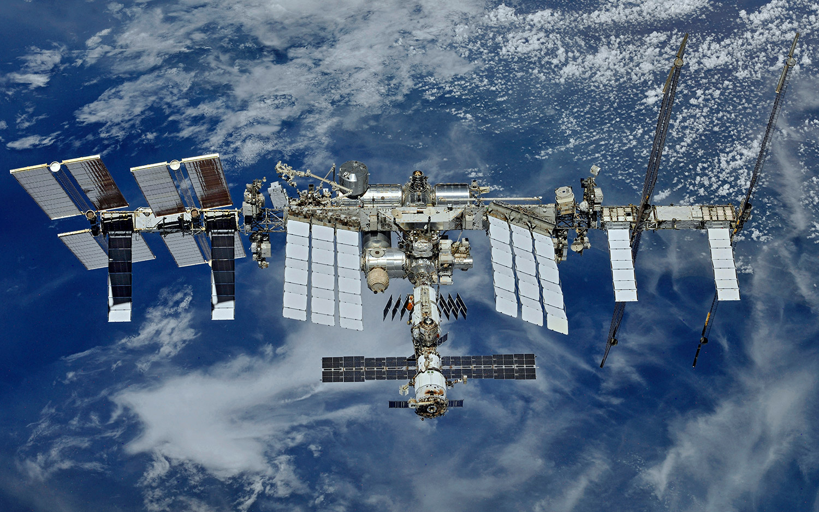
Future work
We can apply our findings with Temporal Studies to analyze the pre-eruptions or post-eruption phases to better understand the mechanisms involved in the solar flares.
Redefining our goals from measuring plasma velocities to using those measurements as a tool for anticipating solar activities.
We can then identify early warning signs of instability in coronal loops ultimately improving space weather prediction Models.
Assist Astronauts to find the most optimal time to travel in space outside their space station in the safest way without any injury form unexpected flares.
International Space Station Modules
https://www.space.com/42495-international-space-station-modules-tour-photos.html

Slide 9
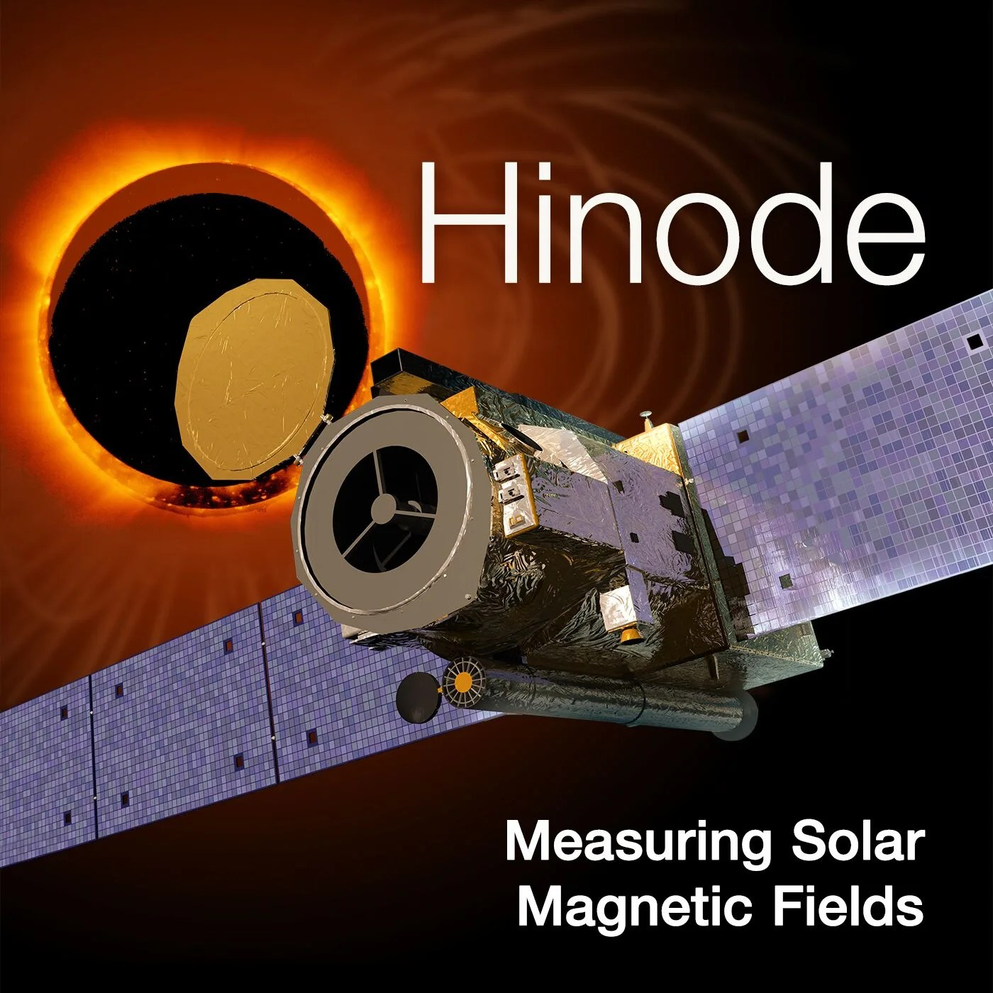

Acknowledgements
This research was made possible through the support of George Mason University’s College of Science, which supports the ASSIP Program. Likewise, Dr. Poland’s guidance throughout the project was essential to our final outcome. Finally, we thank Hinode and EIS for providing open access to their data and software and the U.S. Naval Research Laboratory for the organized catalog.
https://science.nasa.gov/mission/hinode/
https://www.nrl.navy.mil/

Slide 10

Questions?
Key Citations:
1. Brown, C. M., Feldman, U., Seely, J. F., Korendyke, C. M., & Hara, H. (2008). Wavelengths and intensities of spectral lines in the 171–211 and 245–291 Å ranges from five solar regions recorded by the extreme‐Ultraviolet Imaging Spectrometer (EIS) on Hinode. The Astrophysical Journal Supplement Series, 176(2), 511–535. https://doi.org/10.1086/529378
2. EISPAC documentation. eispac Documentation - eispac 0.95.1.dev7+g1b3f96a documentation. (n.d.).
https://eispac.readthedocs.io/en/latest/index.html

Slide 11
Thank You
- Dr. Poland’s 2025 Cohort

