Slide 1

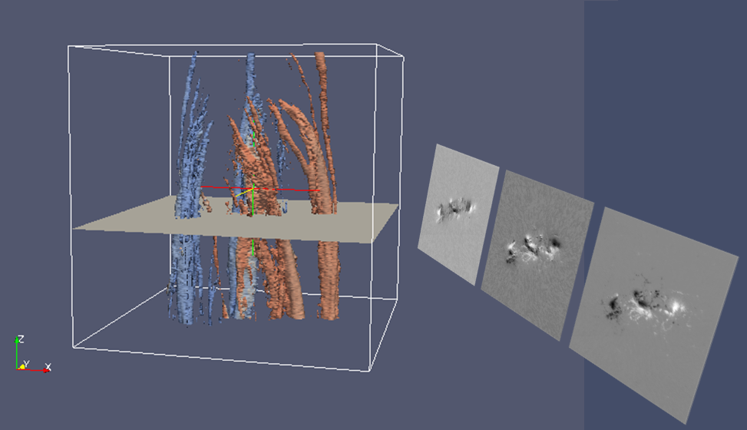
Reconstructing the Subsurface Three-Dimensional Magnetic Structure of Solar Active Regions Using SDO/HMI Observations
Georgios Chintzoglou*, Jie Zhang
School of Physics, Astronomy and Computational Sciences, George Mason University, Fairfax, VA 22030
* gchintzo@gmu.edu
ABSTRACT
OBSERVATIONS AND ANALYSIS
DISCUSSION AND CONCLUSION
A solar active region is a three-dimensional (3D) magnetic structure formed in the convection zone, whose property is fundamentally important for determining the coronal structure and solar activity when emerged. However, our knowledge of the detailed 3D structure prior to its emergence is rather poor, largely limited by the low cadence and sensitivity of previous instruments. Here, using the 720 s magnetic vector observations from the Helioseismic and Magnetic Imager (HMI) on board the Solar Dynamics Observatory, we are able to reconstruct a 3D data cube and infer the detailed subsurface magnetic structure of NOAA AR 11156 and AR 11640. This task is accomplished with the aid of the image-stacking method and advanced 3D visualization. (Chintzoglou and Zhang, 2013)
We observationally infer the height of the emergent magnetic structure by assuming the flux-tube rises as a coherent structure. For AR 11156 we find it to be 60Mm and for AR 11640 is 90Mm.
Our observations suggest that an AR, even appearing highly complicated on the surface, may originate from a simple straight flux tube that undergoes both horizontal and vertical fragmentation during its rise through the solar convection zone.
AR 11156
(SOUTHERN HEMISPHERE)
AR 11640
(NORTHERN HEMISPHERE)
-The asymmetric stretching (Lambda shape) of the flux-tubes is obvious in both reconstruction methods, i.e. the simple Time-Stacking (or constant speed assumption) and the Height-Interpolation (inferred velocity profile from the changing peak-centroid separation Fig 5).
-Instead of coherent, solid flux tubes, we observe a very fragmented, branch-like appearance in all polarities of the bipoles. On the surface, such fragmentation appeared as the continuous emergence of individual small magnetic elements. However, these small magnetic elements exhibit a remarkably ordered, "swarm"-like collective behavior, separating in terms of polarity and coalescing in three dimensions into big "tree-trunks“ that later become still. The still tree trunk effect is, of course, accentuated in the constant speed Time-Stacking (Fig 6α,β), but it is absent in the Height-Interpolation Reconstruction (fig 7).
-It is interesting to note that the 3D topology of the ARs—as inferred by the time-stacking and also the Height-Interpolation Reconstruction – exhibits all the qualitative characteristics of the TFT approximation. The fact that we observe this asymmetry suggests that the upper SCZ does not have a severe impact in altering the magnetic topology of flux-tubes while traversing the lower SCZ, after they are born.
-Our results resemble a lot with results from 3-D anelastic MHD simulations by Fan (2008) for the case of a low-negative twist on a short, buoyant flux-tube, taking the solar rotation under consideration . The simulation goes from the base of the SCZ to a minimum depth of 16Mm under the photosphere (see figure below).
Fig 3. The first 6 days of evolution of the AR 11156 (left) and AR 11640 (right) as observed with SDO/HMI LOS magnetograph (only used here for the illustration). The white cross shows the position of the guiding center of the 240” x 200” FOV at a fixed heliographic latitude.
α
β
INTRODUCTION
The subject of active region (AR) magnetic structure in the Solar Convection Zone (SCZ; outer ~220 Mm of the solar radius) is one of the least understood topics in Solar Physics, but it is of crucial importance for constraining solar dynamo models and explaining what drives solar activity and space weather. It is widely believed that ARs seen on the surface are magnetic flux tubes that are being created by the dynamo process at a depth in the SCZ (Charbonneau 2005). Subsequently, the flux tubes emerge through the photospheric surface giving birth to ARs or sunspots and magnetic loop systems in the corona. On the surface, there is a high order of regularity on the pattern of AR magnetic polarities, well described by Hale's and Joy's laws (Hale et al. 1919). On the other hand, there has been a considerable amount of theoretical work that has been developed over the past four decades trying to attack the issue computationally (for a review, see Fan 2009 and Stein 2012). The models of emergence in the SCZ are (1) the Thin-Flux-Tube model (TFT; Spruit 1981) and (2) the anelastic MHD model (Gough 1969). While both models work well in the lower SCZ, they might not be valid at the top layers of the SCZ (that is, 20–30 Mm below the surface). Also, radiative-convective MHD models provide no explanation on the large-scale characteristics of emerging ARs—such as Joy's law of AR tilts and asymmetric foot-point separation
Fig 4. Unsigned magnetic flux versus time for AR 11156 (left) and AR 11640 (right). The color scheme adopted for visualizing the magnetic polarities is “Doppler shift”-like, i.e. red is pointing inward to the sun (negative B) and blue is outward, i.e. pointing to the observer (positive B).
α
β
Fig 1. Classic cartoon-models of the emergence process. Top: The Thin Flux Tube Approximation (predicts the asymmetric polarity separation due to Coriolis force) (Caligari et al, 1995) Bottom: Observational inference on the emergent structure by Zwaan (1985)
Fig 5. Polarity Separation (Black curve) and Tilt Angle (Green curve) versus time for AR 11156 (left) and AR 11640 (right). Colored vertical lines denote the beginning of a day. The colors correspond to those on the polarity peak-centroid motion x,y-plot (in pixels) as to provide the temporal information for visualizing the motion of polarities (separation and tilt) on the heliographic plane.
α
β
Fig 8. Simulation from Fan, 2008.
|B|=800 G
|B|=1200 G
-The behavior of the two ARs under study with respect to their Tilt angle (green curve. Fig 5α,β) is noteworthy. There is a statistical law for solar ARs (weaker than that of Hale’s law,) called Joy’s Law. That is there’s a weak dependence on the tilt of the bipole with respect to the local line of latitude. This makes ~ two out of every three ARs to point slightly towards the equator, regardless of the hemisphere they are at (Chintzoglou and Zhang, 2011). Although at the end (i.e. after about 4 or 5 days) the bipoles more or less assume a Joy’s law-compliant tilt (positive tilt or around zero), it is very interesting to see that the Northern AR starts with a super-Joy’s law tilt and the Southern starts with a anti-Joy’s law tilt.
-The magnetic structure height we were able to infer with the Height-Interpolation method is not too far away from the deepest detection of magnetic fields by means of local Helio-seismology methods (Ilonidis et al, 2011), i.e. about 65 Mm .
-This study also demonstrates that the image-stacking technique is a promising method for studying the 3D structure of ARs prior to their emergence. In the future, we will study the magnetic vector 3D structure by fully using the magnetic vector observations from the SDO/HMI instrument (B-field streamlines).
METHODOLOGY
t₀
Taking full advantage of the aforementioned high cadence and high spatial resolution observations of the B-field at the (thin) photospheric layer, we treat the subject of AR emergence in the unique following way. After correcting for the solar rotation, we proceed on making a stack of 12 min cadence cutouts on the heliographic plane, and if we start with t₀ at the top of the stack and adding images at later times consecutively at a lower height (the Z dimension), in principle we create a 3D data cube, which can be used to infer the 3D subsurface magnetic structure of the AR prior to its emergence. This technique is based on the assumption that the subsurface AR emerges as a
Fig 6. Three-Dimensional reconstruction with the constant velocity Time-Stacking Technique using HMI vector 720 sec magnetic field observations. The vector data cubes are presented in the form of isosurfaces. Note that the Z-Axis is given in terms of time (in hours, increasing downwards), essentially reflecting the length of the observing period. The small magnetic elements on the top of the cube coalesce and form ‘tree-trunks’, i.e. strong polarities. The X-axis is pointing to the West, and the Y-axis points North. The color coding is “Doppler-shift-like”. The leading polarities obey the Hale’s polarity law (bipoles on same hemispheres have same leading polarity and this changes to opposite with bipoles from different hemispheres)
t_{n}
Fig 2 Illustration showing the 3D reconstruction of the subsurface magnetic structure of the AR 11158 by stacking vector images along the z-dimension (time). A vector image is composed from 3 images, that is the Bx-, By- and Bz-components of the magnetic field vector at the photospheric surface. The Bx, By, Bz images shown above correspond to the plane shown inside the 3D cube.
|B|=1200 G
REFERENCES
Caligari, P., Moreno-Insertis, F., & Schussler, M. 1995, ApJ, 441, 886
Charbonneau, P. 2005, LRSP, 2, 2
Chintzoglou, G. & Zhang, J. 2013 ApJ 764 L3
Chintzoglou, G. & Zhang, J. 2011, AAS-SPD meeting #42, #17.10; AAS Bulletin, Vol. 43
Fan, Y. 2008, ApJ, 676, 680
Fan, Y. 2009, LRSP, 6, 4
Gough, D. O. 1969, JAtS, 26, 448
Hale, G. E., Ellerman, F., Nicholson, S. B., & Joy, A. H. 1919, ApJ, 49, 153
Ilonidis, S., Zhao, J., Kosovichev, A. 2011, Science, 333, 993
Spruit, H. C. 1981, A&A, 98, 155
Stein, R. F. 2012, LRSP, 9, 4
Zwaan, C. 1987, ARA&A, 25, 83
solid body, i.e., the observed flux on the surface at each time instance corresponds to one particular height of the body. As a first-order approximation, the velocity of the emergent structure is assumed constant, thus each frame contributes equally to the height of the structure (Fig 6 α,β).
As an further attempt to get a more detailed picture than the one we get with the assumption of constant speed, we interpolate the height (Z-dimension) of the datacubes with the polarity (peak centroid) relative separation rate (Fig 5α,β, black curve and the small colored plot). Linking the variations of the separation rate with the velocity of a solid emergent structure allows for an estimate on the height of the magnetic structure prior to emergence (Fig 7).
|B|=1200 G
Fig 7. Three-Dimensional reconstruction by using the datacubes above and by interpolating their height with the (relative) polarity separation for each case (black curve in Fig 5α,β) The height of the emergent magnetic structures is estimated to 60 Mm for AR 11156 (slow polarity separation, relatively weak AR) and 90 Mm for AR11640 (faster separation and stronger field). Note that the asymmetric ‘Lambda’ shape of the flux-tubes is retained after the interpolation operation and the ‘tree trunks’ of Fig. 6 are now absent.

