Slide 1

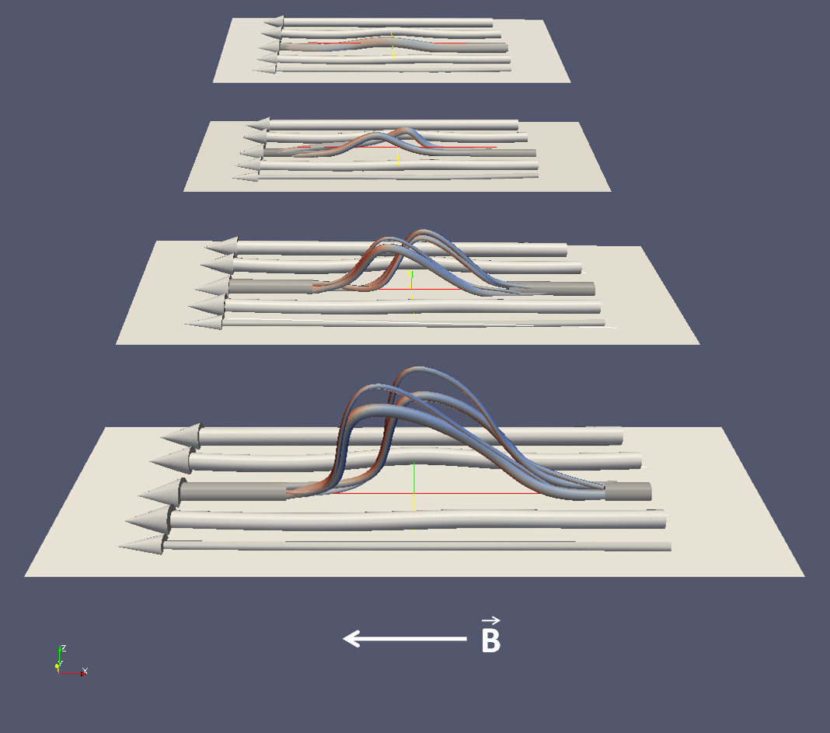
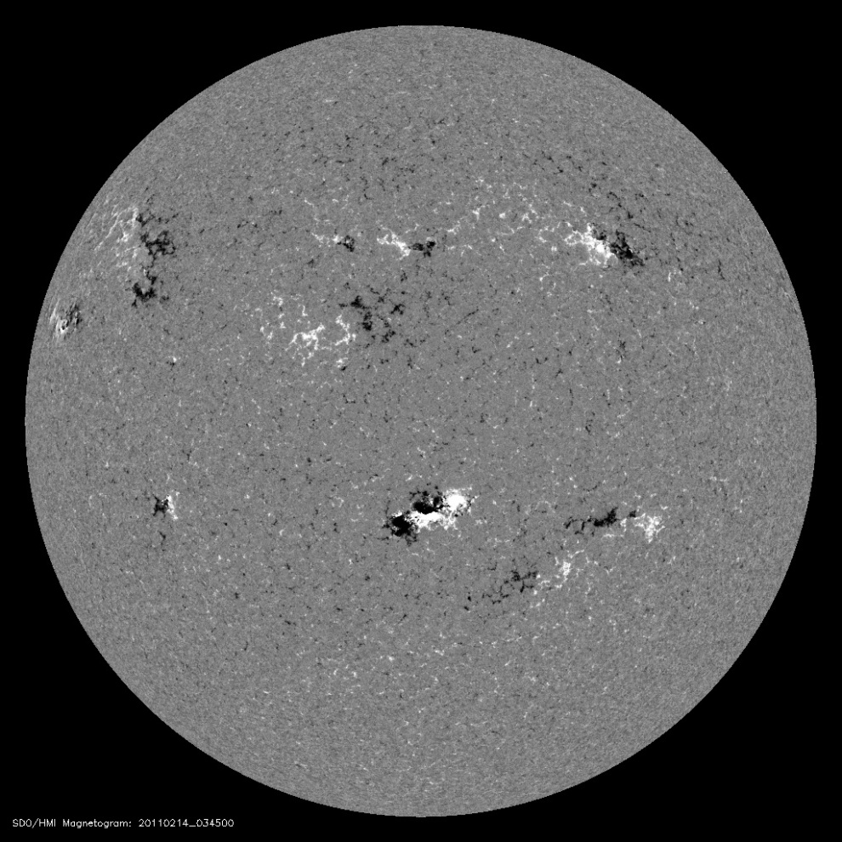
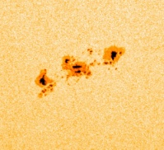

Three-Dimensional Reconstruction of AR 11158
During its Emergence Phase Using SDO/HMI Observations
Georgios Chintzoglou*, Jie Zhang
School of Physics, Astronomy and Computational Sciences, George Mason University, Fairfax, VA 22030
* gchintzo@gmu.edu
ABSTRACT
3-D RECONSTRUCTION
DISCUSSION
A solar active region (AR) is a three dimensional magnetic structure formed in the convection zone, whose property is fundamentally important for determining coronal structure and solar activity when emerged. However, our knowledge on the detailed 3-D structure prior to its emergence is rather poor. Previous observational work on AR emergence has been limited by instrumental capabilities - low ﬁdelity, low-cadence magnetograms. At the same time, our theoretical knowledge relies on overly simpliﬁed assumptions based on MHD simulations or the thin ﬂux tube approximation. Here, we are able to observationally determine and reconstruct the three-dimensional magnetic structure of AR 11158 during the emergence phase and to characterize its magnetic connectivity and topology. This task is accomplished with the aid of the time-stacking method and advanced 3-D visualization, applied on magnetograph observations from the HMI instrument of the SDO mission, taking full advantage of its unprecedented temporal resolution.
We ﬁnd that the AR consists of two major dipoles. The two polarities of each dipole show interesting tree-like structure, i.e. while the bottom of the polarity appears as a single trunk-like ﬂux tube, the top of the polarity has multiple branches, consisting of smaller and thinner ﬂux tubes which connect to the branches of the opposite polarity. The four roots of the two dipoles align well along a straight line, while the top branches are slightly non-coplanar. The detailed 3-D topology and connectivity of AR 11158 will be presented in this meeting.
From the Flux time-profile in Fig. 4 we see that for an individual bipole (i.e. N1P1 and N2P2) the magnetic flux of its positive and negative polarity is – to a first order – similar. Also, in both bipoles, two major flux injection phases are identified, with the initial one being moderate (“Ba”) and the later one (“Bb”) being a very much stronger “flux surge.” Those phases are understood as two adjacent, flux-tube “fronts” or flux-tube “branches” as it is also suggested by the 3-D reconstruction of Fig. 3. In each of the bipoles, the branch that arrives first at the photosphere, Ba, appears fragmented whereas the branch that arrives 2 days later, Bb, is much more coherent as a structure. Moreover, both of bipole branches are consisted of finer branches as it can be seen in the 400 G iso-surface reconstruction. In Fig. 3 there’s a lag of the positive flux (leading polarity) with respect to its negative counterpart (following), in both bipoles, at emergence phase. This, together with the fact that the emerging leading polarity moves faster on the photosphere than the following polarity, suggests that the tilt of the leading polarity we see on Fig. 3 is true, as the
B LOS component in the leading polarities is smaller than that of the trailing, i.e. the field in the
leading part of the flux-tubes is more oblique with respect to the almost parallel to the LOS field of the trailing polarities. Finally, the shape of the two flux-tubes as well as their proximity, implies that their roots in the SCZ might be common (see Fig 5. summarizing the above)
INTRODUCTION
The NOAA AR group 11158 is known to be the one that produced the first X-class flare (X2.2) of the Solar cycle 24. The beginning of emergence starts on 09-Feb-2011 22:00:00 close to the East limb. The white-light photospheric and B LOS images show a very complex AR, consisting of two colliding bipoles. This AR is classified as a δ-spot (see Liu & Zhang 2002). From the space weather perspective, δ-spot ARs are of great importance, being the most Flare- and CME-productive ARs (Leka et al. 1996.) However, with our reconstruction method, it is rather evident that AR 11158 is a quadrupolar AR (two big bipoles). Also, the collinearity and convergence of the like polarities of the bipoles at the bottom of the 3-D cube, suggest that they might be related, even originating from the same parent magnetic flux-tube. Such an observation would have been impossible without the implementation of our method.
N2
P2
N1
P1
Fig 5. Model sketch of the emergence phase of a δ-spot AR under the photosphere. The plane is the bottom of the SCZ. The cylindrical structures shown at the bottom of SCZ are the flux-tubes of the toroidal field, generated by the solar dynamo process. For flux tubes created in the South hemisphere during Solar Cycle 24 (like those of the AR 11158), the magnetic field vector along the tubes is directed from West-to-East (here from right-to-left), as dictated by Hale’s law and the Babcock-Leighton dynamo theory. The flux-tubes develop an asymmetry due to the Coriolis force (Caligari et. al, 1995.)
Fig 1. The AR 11158 crossing the central meridian on 14-Feb-2011 03:45 UT as seen in the SDO/HMI LOS magnetograph. The red box shows the cutout size used in our analysis. Bottom right: the AR in white light.
Fig 3. The 3-D reconstruction of AR 11158 using the time-stacking method on SDO/HMI LOS magnetograms. The flux-tubes shown here are at |B_{n}|= 400 G (up) and 1100 G (down). The color scheme adopted for visualizing the magnetic polarities is “Doppler shift”-like, i.e. red is pointing inward to the sun (negative B) and blue is outward, i.e. pointing to the observer (positive B). On top of each datacube is the last HMI BLOS frame of the cube, i.e. the bottom frame, on 14-Feb-2011 04:25:57. The total duration of the observation is 100.43 hours. The positive X-axis direction is westward and Y-axis northward. The size of X-axis is the same with the height of the Solar Convection Zone (SCZ), i.e. about 200Mm.
CONCLUSION
-BIFURCATION IN LONGITUDE AND LATITUDE: The AR11158 is the one that gave the first X-class flare of the Solar Cycle 24. At a first sight, it’s magnetic topology seems rather complex but the collinearity and coalescence of the like polarities of the bipoles at the bottom of the 3-D cube, suggest that they might be related, even originating from the same parent magnetic flux-tube. This picture is therefore suggesting that a sub-photospheric flux-tube has been bifurcated both in longitude and latitude (see fig. 5)
MAGNETIC FLUX TIME-PROFILE
Bipole | Polarity | Branch | Injection Rate (x 10¹⁶ Mx s⁻¹) | Total Flux (x 10²³ Mx) | Start Time (UT) | End Time (UT) | Duration (hours)
1 | P1 | a | 1.52 | 2.71 | 10-Feb-2011 16:27 | 12-Feb-2011 00:00 | 31.66
 |  | b | 3.79 | 7.12 | 12-Feb-2011 18:06 | 13-Feb-2011 18:30 | 24.50
 | N1 | a | 1.75 | 2.82 | 10-Feb-2011 15:52 | 11-Feb-2011 20:03 | 28.16
 |  | b | 4.82 | 5.69 | 12-Feb-2011 16:43 | 13-Feb-2011 13:10 | 20.50
2 | P2 | a | 0.69 | 2.18 | 10-Feb-2011 23:24 | 12-Feb-2011 13:21 | 37.99
 |  | b | 2.73 | 22.27 | 12-Feb-2011 13:21 | 15-Feb-2011 06:00 | 64.64
 | N2 | a | 0.91 | 2.58 | 10-Feb-2011 21:40 | 12-Feb-2011 11:40 | 39.99
 |  | b | 3.21 | 18.97 | 12-Feb-2011 11:40 | 14-Feb-2011 16:30 | 52.88
“SURGE” or BRANCH-b
“FRONT” or BRANCH-a
-OBSERVE FLUX SURGE IN BOTH BIPOLES: Obviously, this secondary emergence or “surge” event consists of multiple branches. However, these can be grouped into one big “Branch-b” (i.e. see onsets of N1Bb, N2Bb in fig 4) for each dipole as suggested by the Flux vs. time diagram. Thus, for each dipole we have a bifurcation in height as well (See fig 3,4,5).
-NON-PLANAR FLUX TUBES: Flux tubes are non-planar and the already emergent loops (“Ba’s”) seem to “know in advance” about the arrival of the stronger flux “surge” tubes (or b-branches), suggesting that the “Bb’s” interact/collide sub-photospherically with the trunks of the “Ba” photospheric foot-points, while they are still being anchored deep in the SCZ.
-LAMBDA SHAPE TUBES: There is a persistent lagging of the flux of P1 and P2 as compared to N1 and N2 during the primary and secondary emergence phase, indicating that the emerging flux tubes are indeed more horizontal in the leading side. Thus, the shape best describing the overall magnetic structure is the (Archaic) Greek letter Lambda “ ” instead of the much more popular and extensively used in the literature Omega (Ω).
Fig 2. The first 6 days of evolution of the AR 11158 as observed with SDO/HMI LOS magnetograph. The individual polarities are named after which bipole emerged first, e.g. bipole 1, so we name its negative polarity N1 and its positive P1, and with N2 and P2 emerging later. The white cross shows the position of the guiding center of the 240” x 200” FOV with fixed heliographic latitude φ=-20°.
METHODOLOGY
Taking full advantage of the aforementioned high cadence and high spatial resolution observations of the B-field at the (thin) photospheric layer, we treat the subject of AR emergence in the unique following way. After correcting for the solar rotation, we proceed on making a stack of 7.5 min cadence 2-D cutouts, and if we start with t₀ at the top of the stack, in principle, we reconstruct the emerging magnetic structure of the field as it is directly below the photosphere. As a first-order approximation, the velocity of the emergent structure is considered constant, thus each frame contributes equally to the height of the structure.
Fig 4. The time evolution of the flux for the bipoles N1P1 (solid lines) and N2P2 (dashed) suggests that both have an early emergence phase (i.e. “Ba”) or “front” of flux, followed by a strong flux “surge” (or “Bb”) as also can be seen in Fig 3. Note the persistent lagging of the positive, i.e. leading polarities, P1 and P2 with respect to the following N1 and N2.
See Table with information on the onset/end of emergence, flux injection rates and total flux for each of the branch polarities. The green lines denote the onset of emergence events. Black line fits are ending with an error bar in time, showing the reading error on the end time of emergence (±2 h for Ba’s, ±6 h for Bb’s)

